Slide 1


Penny Search Activity

Slide 2
“Find the Oldest Penny” Activity
Divide into groups, hand out lab sheets, group members write your names (legibly) on the group lab sheet.
Number of Students in Class | Number of Groups | Number of Students in each Group
17 | 3 | 2 groups of 6 students, 1 group of 5 students
18 | 3 | 3 groups of 6 students
19 | 4 | 3 groups of 5 students, 1 group of 4 students
20 | 4 | 4 groups of 5 students
21 | 4 | 3 groups of 5 students, 1 group of 6 students
22 | 4 | 2 groups of 5 students, 2 groups of 6 students
23 | 4 | 3 groups of 6 students, 1 group of 5 students
24 | 4 | 4 groups of 6 students
25 | 5 | 5 groups of 5 students
26 | 5 | 4 groups of 5 students, 1 group of 6 students
27 | 5 | 3 groups of 5 students, 2 groups of 6 students
28 | 5 | 3 groups of 6 students, 2 groups of 5 students
29 | 5 | 4 groups of 6 students, 1 group of 5 students
30 | 5 | 5 groups of 6 students

Slide 3

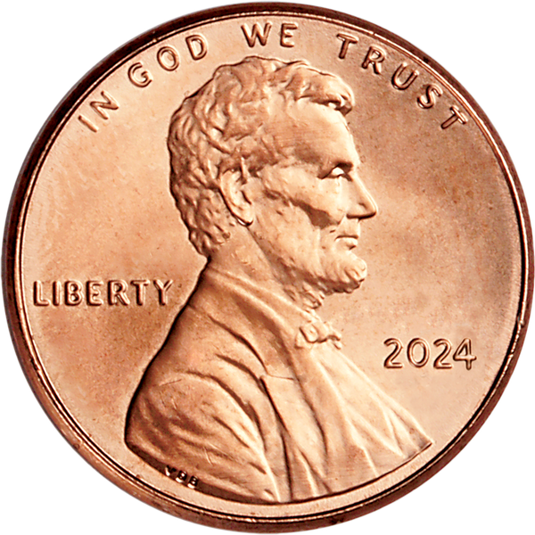
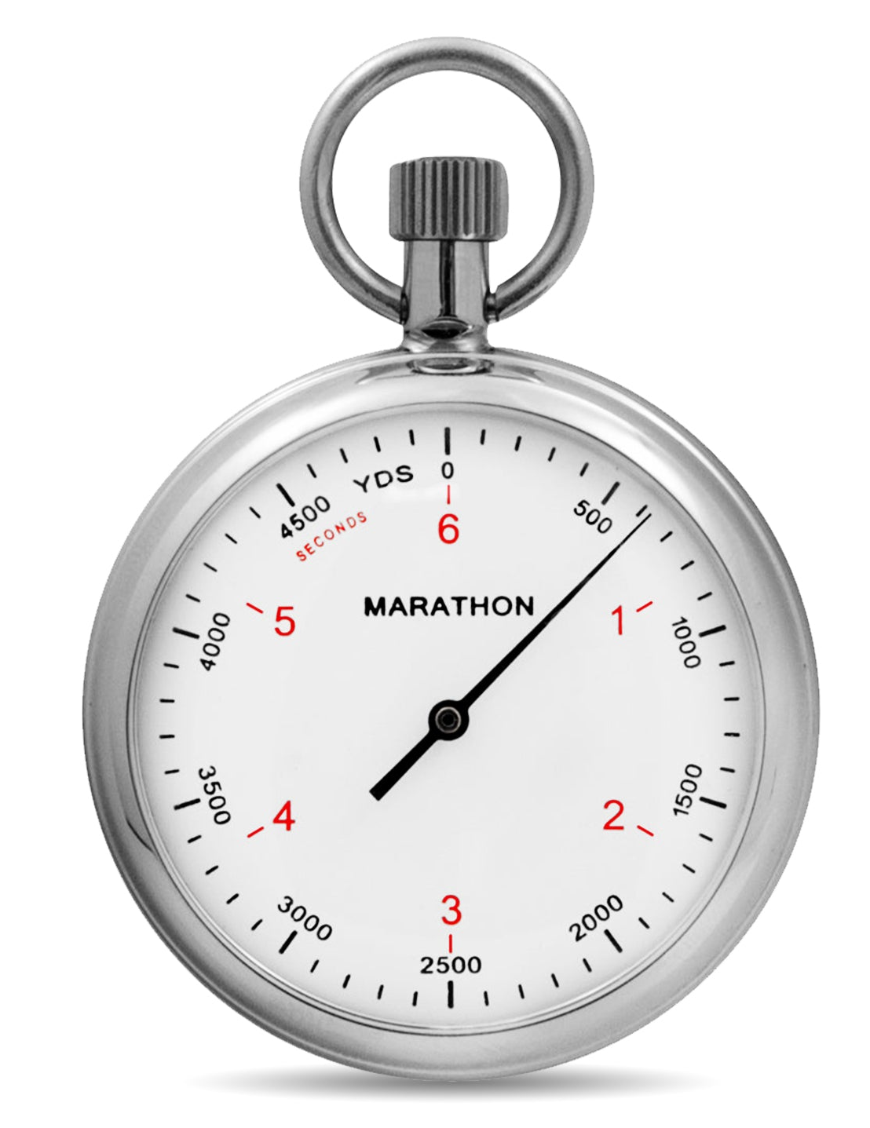
Penny Search Activity PHASE 1
Each group gets 1 bag of 50 pennies!
GROUP MEMBER ROLES
What You Do
Student 1 – sorter
Student 2 – timer
Student 3 – observer
Student 4 – observer
Student 5 – observer
Student 6 - observer
Sorter – look at each penny in your bag one at a time to find the oldest penny. You can’t get help from other students.
Timer – time how long it takes for the sorter to find the oldest penny. Then, write the time on your group’s lab sheet beside PHASE 1.

Slide 4
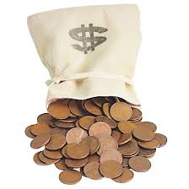
Penny Search Activity PHASE 1 - Discussion
Return your bag of pennies to the lab instructors.
What did PHASE 1 represent?
This phase represents a purely sequential algorithm where there is only one thread (or worker) performing the task. There is no parallelism, and the task is completed by a single worker from start to finish. This is akin to a single-core processing model in computing where no parallel execution takes place.
Question:
If we were to divide the pennies up in the beginning and have multiple sorters, do you think this would take more or less time?
Single-Core Architecture
CPU
CORE
L2 Cache
Memory

Slide 5
Penny Search Activity PHASE 2
Each group gets 2 bags of 25 pennies!
Suggest making observers from Phase 1 be sorters/ timer in Phase 2!
GROUP MEMBER ROLES
What You Do
Student 1 – sorter
Student 2 – sorter
Student 3 – timer
Student 4 – observer
Student 5 – observer
Student 6 - observer
Sorters – look at each penny in your individual bags one at a time to find the oldest penny. You can’t get help from other students. Then, when you have BOTH found the oldest in your bags, compare your oldest and select the oldest between the two.
Timer – time how long it takes for the sorters to find the oldest penny. Then, write the time on your group’s lab sheet beside PHASE 2.

Slide 6
Penny Search Activity PHASE 2 - Discussion
Return your bags of pennies to the lab instructors.
What did PHASE 2 represent?
In this phase, two independent tasks (sorting two separate bags) are executed concurrently. This represents task parallelism, where multiple workers perform tasks in parallel and then synchronize (compare results) at the end. The synchronization step is the comparison of the oldest pennies from the two bags, which ensures that the final result is the overall oldest penny.
Multi-Core Architecture
CPU
CORE 0
CORE 1
L2 Cache
L2 Cache
Memory

Slide 7
Penny Search Activity PHASE 2 - Discussion
Return your bags of pennies to the lab instructors.
Discussion Questions:
How did dividing the task between two people (parallel sorting) affect the overall time compared to Phase 1 (sequential sorting)? Did you experience speedup?
If each person worked at different speeds, how might that affect the overall time it takes to find the oldest penny?
Would adding more people (more sorters with smaller bags of pennies) make this task faster? Why or why not?
Notes:
#2 question should lead to a discussion about load balancing and how the performance of parallel tasks can be uneven if processors work at different speeds.
#3 question can encourage students to think about scalability in parallel programs and the potential diminishing returns when adding more workers.

Slide 8
Penny Search Activity PHASE 3
GROUP MEMBER ROLES
What You Do
Sorters – look at each penny one at a time to find the oldest penny. You can’t get help from other students. Then, when you have ALL found the oldest out of your pennies, compare your oldest and select the oldest between the sorters.
Timer – time how long it takes for the sorters to find the oldest penny. Then, write the time on your group’s lab sheet beside PHASE 3.
Student 1 – timer
Student 2 – large-sorter
Student 3 – mini-sorter
Student 4 – mini-sorter
Student 5 – mini-sorter
Student 6 – mini-sorter

Slide 9
Penny Search Activity PHASE 3 - Discussion
Return your bags of pennies to the lab instructors.
What did PHASE 3 represent?
This phase introduces data parallelism, where the dataset (pennies) is divided among multiple workers. However, there is load imbalance, as one student has significantly more pennies to sort than the others. This imbalance reflects real-world scenarios where tasks are unevenly distributed among parallel workers, which can lead to inefficiencies. After sorting, the students must communicate (synchronize) to combine their results and identify the oldest penny.
Multi-Core Architecture
CPU
CORE 0
CORE 1
CORE 2
CORE 3
L2 Cache
L2 Cache
L2 Cache
L2 Cache
Memory

Slide 10
Penny Search Activity PHASE 4
Each person gets 1 penny.
GROUP MEMBER ROLES
What You Do
Sorter – without yelling across the room and with only talking to 1 other student at a time, compare each of your pennies to find the oldest penny in the class.
Timer – time how long it takes the class to find the oldest penny. Then, tell the students so the student with the group lab sheet can write that down.
Student 1 – sorter
Lab Instructor - timer

Slide 11
Penny Search Activity PHASE 4 - Discussion
Return your bags of pennies to the lab instructors.
What did PHASE 4 represent?
This phase also represents data parallelism, where the dataset (pennies) is divided among multiple workers (each worker only has one penny). With the data being spread across so many workers, the synchronization step where results need to be merged ends up taking more time than the actual work, and this affects speed-up.

Slide 12
END

